Slide 1

Everything is Relative: Relational Responding, Perspective-Taking, and Psychological Flexibility in the Parent Child Relationship
Danielle N. Moyer
Emily K. Sandoz, Ph.D.
Notes:
Danielle Moyer
University of Louisiana at Lafayette
Louisiana Contextual Science Research lab
Dr. Emily Sandoz

Slide 2

Notes:
My research in particular focuses on psychological flexibility in the parent child relationship
It is important to me to use science to help children and parents develop healthy relationships

Slide 3
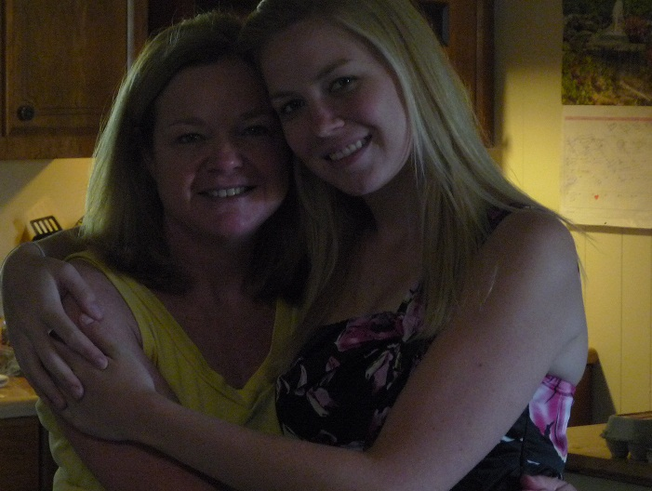
Notes:
My mom

Slide 4

Notes:
Parenting is hard
But at the same time it is really rewarding and important
The problem is that it is SO important, and it is SO stressful at the same time that it can often be overwhelming
So how do parents do it? Well, some of them really struggle

Slide 5

6
Notes:
6 million children are victims of child abuse in the united states each year
Parents who suffer from depression or anxiety are more likely to use ineffective parenting techniques
Depressed parents use more criticism, spanking and other aversive behaviors
Anxious parents are less nurturing, more restrictive, and more psychologically and behaviorally controlling

Slide 6

Notes:
1 in 5 adults will be diagnosed with anxiety in a year

Slide 7

Notes:
And 1 in 7 will be diagnosed with depression

Slide 8

Notes:
Children of parents who suffer from anxiety and depression are up to 7 times more likely to develop similar patterns of distress
Research on the parent child relationship has shown us that there are many variables in the transmission of distress from parent to child
But the exact mediators of this relationship continue to remain unclear

Slide 9
Present Moment
Experiential
Acceptance
Committed
Action
Cognitive
Defusion
Valued
Living
Self as Context
Notes:
A functional contextual approach
Psychological Flexibility
There are six components of psychological flexibility
Some researchers have already begun to look explicitly at some of these components in the parent child relationship

Slide 10

Notes:
Parental experiential avoidance
Targeting expression of emotion
PEA accounted for significant variability in child anxiety

Slide 11

Notes:
Cognitive Fusion – rigid thinking
When parents respond to thoughts about their children or themselves as parents in terms of the literally content
Research shows that emotionally relevant stimuli are difficult to relate in new ways

Slide 12
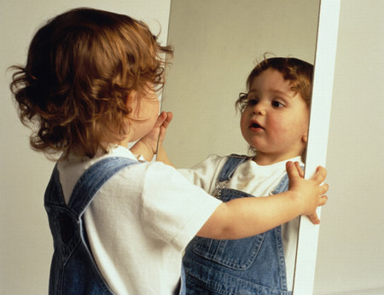
Notes:
The self and perspective taking
Perspective taking is the ability to discriminate one’s own perspective from the perspective of others
Perspective taking is an important skill that is related to many aspects of life including education, awareness, compassion, cooperation, and empathy

Slide 13

Notes:
Parents are the very first teachers of perspective taking
And research shows that empathetic understanding in parents is important to a child’s development

Slide 14

Notes:
Just a word of caution
This is just a conceptual analysis developed out of our brainstorming
The theory behind it is that perspective taking is a learned skill and if it’s learned that it can also go wrong
We are open to more conversation

Slide 15
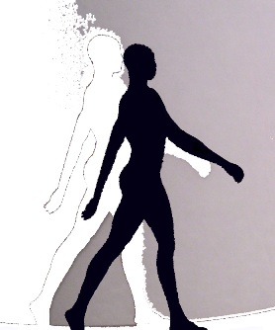
Self
Impoverished
Rigid
Notes:
One way to look at perspective taking is that there are two components of perspective taking: the self and others
The first component I’m going to talk about is the self
Two different patterns of inflexibility

Slide 16

Impoverished
Rigid
Notes:
Unstable sense of self
What kind of learning history might
Example

Slide 17
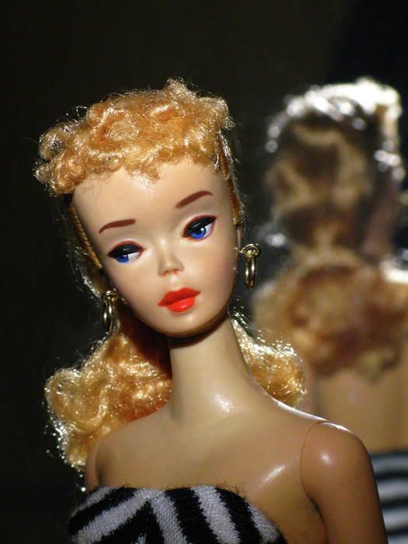
Impoverished
Rigid
Notes:
Rigid sense of self
Learning history example
Best intentions
Sister example

Slide 18
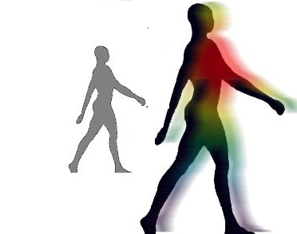
Others
Impoverished
Rigid
Notes:
The other component of perspective taking is the ability to take the perspective of others
This skill can similarly go wrong

Slide 19

Impoverished
Rigid
Notes:
Inability to see shared experiences
Learning history example

Slide 20
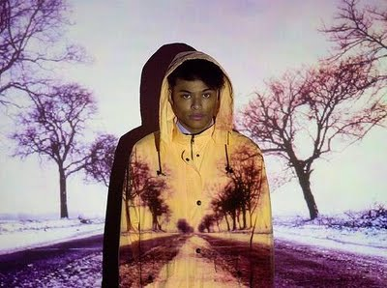
Impoverished
Rigid
Notes:
Pseudo Perspective Taking e.g. Projection
Relationship example
Learning history example

Slide 21
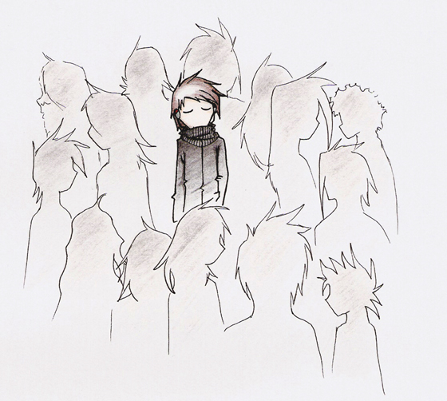
Impoverished
Rigid
Notes:
Rigid sense of others’ perspective
Learning History example

Slide 22
Notes:
Connect back to thesis
Need research
Mechanisms of change
Developing effective interventions

Slide 23
Danielle N. Moyer
dnm9899@louisiana.edu
Emily K. Sandoz, Ph.D.
sandozpsyclab@gmail.com
Louisiana Contextual Science Research Group
Notes:
Feel free to email me with any questions
Thank Lab and Emily
And Ole Miss

